Slide 1
Normal Distribution
Eric Scott

Slide 2
New Distribution(s): normal
AKA “gaussian”
Symmetrical
Continuous
Mean ($μ$) and variance ($σ^{2}$) are not related
unbounded (-inf to inf)
application: data with continous variation and approx. symmetrical distribution
link = “identity”

Slide 3
Normal Distributions
df <- tibble(x = seq(-15, 15, 0.1), y1 = dnorm(x, mean = 0, sd = 0.5), y2 = dnorm(x, mean = 0, sd = 1), y3 = dnorm(x, mean = 3, sd = 3) ) %>% pivot_longer(starts_with("y"), names_to = "dist", values_to = "y") ggplot(df, aes(x = x, y = y, color = dist)) + geom_line() + scale_color_manual("Parameters", values = c("y1" = "red", "y2" = "darkgreen", "y3" = "blue"), breaks = c("y1", "y2", "y3"), labels = lapply(c("$\\mu = 0$, $\\sigma = 0.5$", "$\\mu = 0$, $\\sigma = 1$", "$\\mu = 3$, $\\sigma = 3$"), TeX)) + scale_x_continuous("Value (e.g. height)") + scale_y_continuous("Probability", limits = c(0,1))

Slide 4
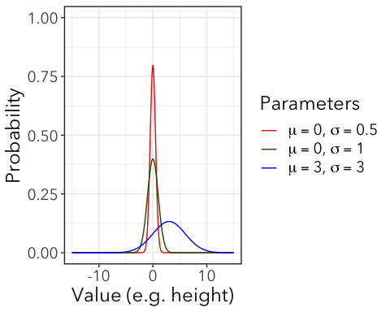

Slide 5
labs(x = "Value (e.g. height)", y = "Probability")
## $x ## [1] "Value (e.g. height)" ## ## $y ## [1] "Probability" ## ## attr(,"class") ## [1] "labels"
Variance is not a function of the mean (less specific assumptions about generating processes)

Slide 6
Why so common?
Few ecological variables are strictly Normal, but many are approximately Normal.
The sum or average of a large number of samples from any distribution will be normally distributed, even if the starting distribution is extremely skewed (not symmetrical)
skewed <- rpois(5000, 2) ggplot(enframe(skewed), aes(value)) + geom_bar() + labs(title = TeX("Poisson ($\\lambda = 2$)"), x = "Count", y = "Frequency")

Slide 7
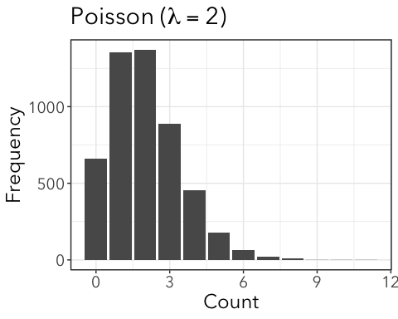

Slide 8
tibble(draw = 1:1000) %>% mutate(sample_mean = imap_dbl(draw, ~mean(sample(skewed, 100)))) %>% ggplot(aes(x = sample_mean)) + geom_histogram(bins = 15) + labs(title = "Means of 100 datapoints sampled from Poisson", x = "Sample means", y = "Frequency")

Slide 9
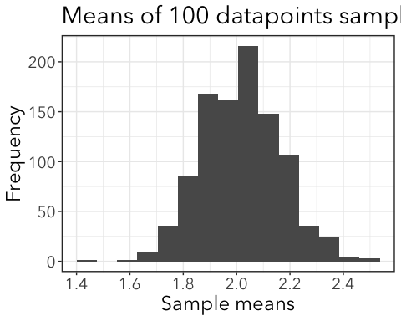

Slide 10
Many biological quantities are controlled by multiple additive factors.
E.g. polygenic traits—many genes (and parts of the environment) control height in humans, each one controling some aspect of growth. Added together, height is continuous.
The product of a large number of samples from any positive (>0) distribution will be log-normally distributed.
bimodal <- tibble(x = c(rnorm(1000, 100, 40), rnorm(1000, 200, 100))) %>% filter(x > 0) ggplot(bimodal, aes(x)) + geom_histogram(bins = 40) + labs(title = TeX("Weird Shaped Distribution"), x = "Value", y = "Frequency")

Slide 11
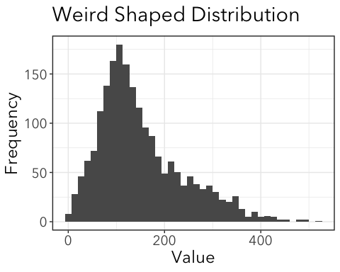

Slide 12
prods <- tibble(draw = 1:1000) %>% mutate(sample_prod = imap_dbl(draw, ~prod(sample(bimodal$x, 10)))) ggplot(prods,aes(x = sample_prod)) + geom_histogram(bins = 15) + labs(title = "Products of 50 datapoints", x = "Sample products", y = "Frequency")

Slide 13
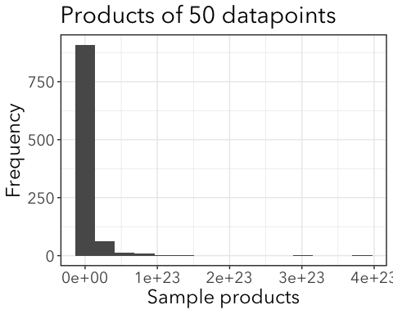

Slide 14
ggplot(prods, aes(x = log(sample_prod))) + geom_histogram(bins = 15) + labs(title = "log(Products of 50 datapoints)", x = "log(Sample products)", y = "Frequency")

Slide 15
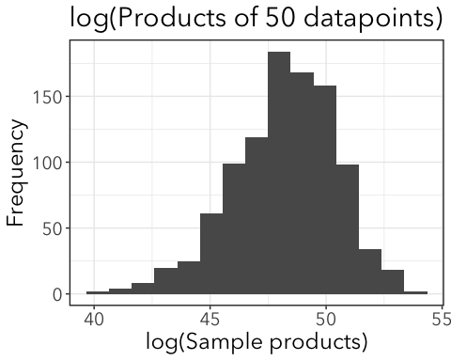

Slide 16
Thus, if the random variable X is log-normally distributed, then Y=log(X) has normal distirbuttion, A random variable which is log-normally distributed takes only positive real values.
Skewed distributions are particularly common when mean values are low, variances large, and values cannot be negative. E.g. % area of tea leaves damaged by leafhoppers.

Slide 17
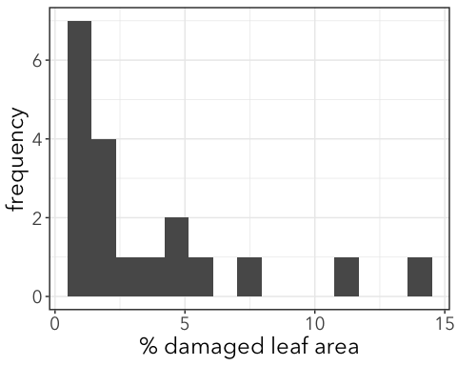

Slide 18
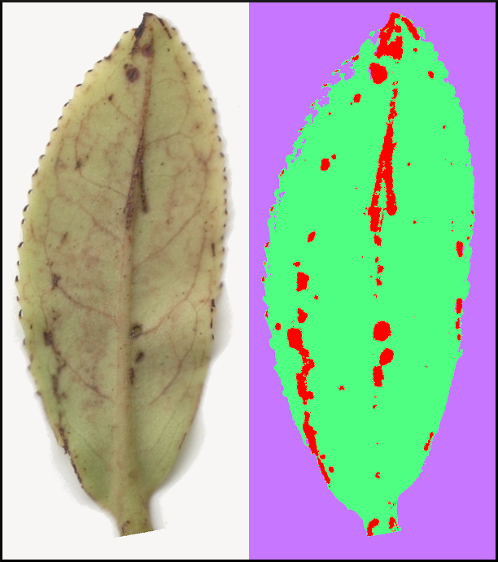

Slide 19
Probability density function (PDF)
$$P[x|μ,σ]=\frac{exp\left[−\frac{1}{2}{\left(\frac{x−μ}{σ}\right)}^{2}\right]}{σ\sqrt{2π}}$$
* You do not need to know how to use this equation.
In R:
dnorm(x = 1, mean = 0, sd = 1)
## [1] 0.2419707

Slide 20
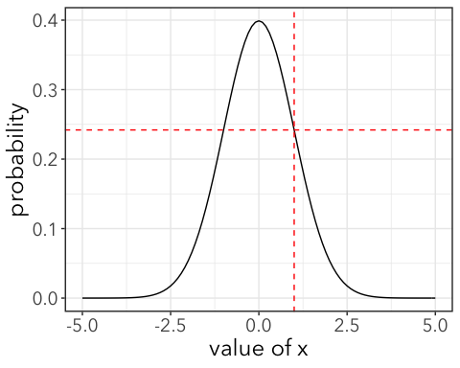

Slide 21
Any value is possible, but some are highly unlikely.

Slide 22
Cumulative Density Function (CDF)
-CDF is the area under the normal curve. -So if we want to know P[x ≤ 1], we can use the CDF.
-in R:
pnorm(1, lower.tail = TRUE)
## [1] 0.8413447
Same as:
pdfplot + cdfplot

Slide 23
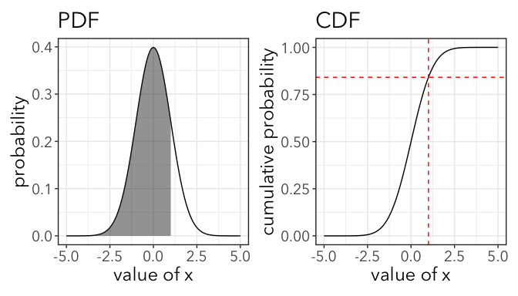

Slide 24
84% of PDF is below x = 0.5

Slide 25
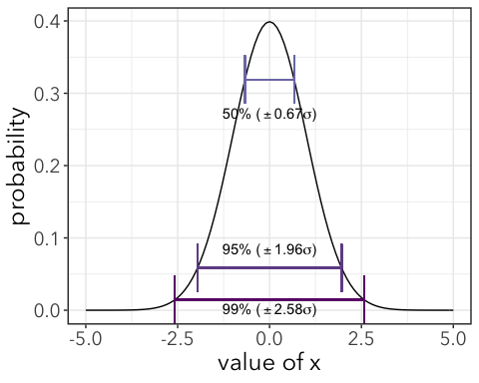
Standard Deviations

Slide 26
Example: Effects of herbicide on caterpillar growth
Lee’s slides
cats <- read_csv(here("data", "HerbicideCaterpillars.csv")) %>% janitor::clean_names() head(cats)
## # A tibble: 6 x 4 ## species host treat mass ## <chr> <chr> <chr> <dbl> ## 1 TCB Castilleja Control 4.53 ## 2 TCB Castilleja Control 3.67 ## 3 TCB Castilleja Control 5.84 ## 4 TCB Castilleja Control 2 ## 5 TCB Castilleja Control 4.25 ## 6 TCB Castilleja Control 5.44

Slide 27
0. All have the same mass
$$E[x_{i}]=β_{0}$$
$$x_{i}∼Normal(E[x_{i}],σ)$$
m0 <- glm(mass ~ 1, family = gaussian(link = "identity"), data = cats) coef(m0) #the mean mass
## (Intercept) ## 5.621378
summary(m0)$dispersion #residual variance
## [1] 4.13701
sqrt(summary(m0)$dispersion) #residual standard deviation
## [1] 2.033964
sd(cats$mass)
## [1] 2.033964

Slide 28
1. Effect of herbicide
Linear model with a dummy variable: H_i_ = 1 if herbicide, 0 if control
$$E[x_{i}]=β_{0}+β_{1}H_{i}$$
$$x_{i}∼Normal(E[x_{i}],σ)$$
m1 <- glm(mass ~ treat, family = gaussian(link = "identity"), data = cats) coef(m1)
## (Intercept) treatHerbicide ## 5.8492466 -0.4707064
sqrt(summary(m1)$dispersion) #residual standard deviation
## [1] 2.023859

Slide 29
1. Effect of herbicide plot
cats %>% group_by(treat) %>% summarize(mean_mass = mean(mass)) %>% ggplot(aes(x = treat, y = mean_mass)) + geom_point(shape = "square", size = 3) + geom_line(aes(group = 1)) + labs(x = "Treatment", y = "Mean Mass (g)")

Slide 30
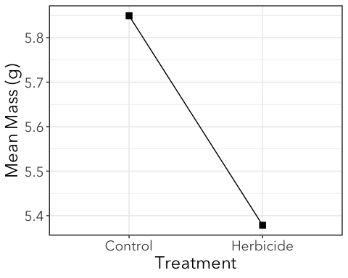

Slide 31
2. Effect of host plant
Linear model with a different dummy variable: P_i_ = 1 if Plantago, 0 if Castileja
$$E[x_{i}]=β_{0}+β_{1}P_{i}$$
$$x_{i}∼Normal(E[x_{i}],σ)$$
m2 <- glm(mass ~ host, family = gaussian(link = "identity"), data = cats) coef(m2)
## (Intercept) hostPlantago ## 4.063208 2.491312
sqrt(summary(m2)$dispersion) #residual standard deviation
## [1] 1.639326

Slide 32
2. Effect of host plant
cats %>% group_by(host) %>% summarize(mean_mass = mean(mass)) %>% ggplot(aes(x = host, y = mean_mass)) + geom_point(shape = "square", size = 3) + geom_line(aes(group = 1)) + labs(x = "Host Plant", y = "Mean Mass (g)")

Slide 33
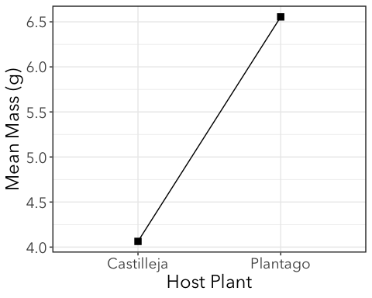

Slide 34
3. Effects of both herbicide and host
Two dummy variables:
H_i_ = 1 if herbicide, 0 if control
P_i_ = 1 if Plantago, 0 if Castileja
$$E[x_{i}]=β_{0}+β_{1}H_{i}+β_{2}P_{i}$$
$$x_{i}∼Normal(E[x_{i}],σ)$$
m3 <- glm(mass ~ host + treat, family = gaussian(link = "identity"), data = cats) coef(m3)
## (Intercept) hostPlantago treatHerbicide ## 4.2950179 2.4935977 -0.4818018
How to interpret? Plug in betas and try dummy variables for different combinations of host and treatment
sqrt(summary(m3)$dispersion) #residual standard deviation
## [1] 1.624313

Slide 35
3. Effect of host and treatment
tibble(host = c("Castileja", "Castileja", "Plantago", "Plantago"), treat = c("Control", "Herbicide", "Control", "Herbicide"), mean_mass = c(coef(m3)[1], coef(m3)[1] + coef(m3)[3], coef(m3)[1] + coef(m3)[2], coef(m3)[1] + coef(m3)[2] + coef(m3)[3] )) %>% ggplot(aes(x = host, y = mean_mass, color = treat)) + geom_point(shape = "square", size = 3) + geom_line(aes(group = treat)) + labs(x = "Host Plant", y = "Mean Mass (g)", color = "Treatment")

Slide 36
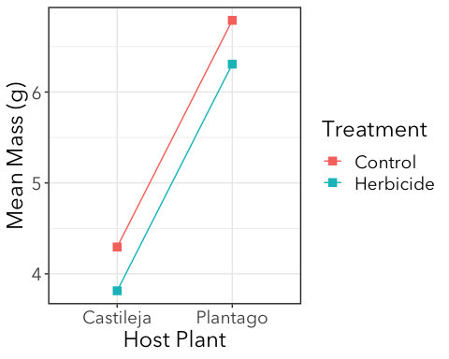

Slide 37
4. Interaction between host plant and treatment
This allows the effects of herbicide to differ between Plantago and Castileja (or, conversely the effect of host plant to differ among levels of the herbicide treatment).
$$E[x_{i}]=β_{0}+β_{1}H_{i}+β_{2}P_{i}+β_{3}H_{i}P_{i}$$
m4 <- glm(mass ~ host + treat + host:treat, family = gaussian(link = "identity"), data = cats) coef(m4)
## (Intercept) hostPlantago ## 4.3443636 2.4144276 ## treatHerbicide hostPlantago:treatHerbicide ## -0.5843636 0.1639445
How to interpret? Plug in betas and try dummy variables for different combinations of host and treatment
sqrt(summary(m4)$dispersion) #residual standard deviation
## [1] 1.626731

Slide 38
4. Interaction
tibble(host = c("Castileja", "Castileja", "Plantago", "Plantago"), treat = c("Control", "Herbicide", "Control", "Herbicide"), mean_mass = c(coef(m4)[1], coef(m4)[1] + coef(m4)[3], coef(m4)[1] + coef(m4)[2], coef(m4)[1] + coef(m4)[2] + coef(m4)[3] + coef(m4)[4] )) %>% ggplot(aes(x = host, y = mean_mass, color = treat)) + geom_point(shape = "square", size = 3) + geom_line(aes(group = treat)) + labs(x = "Host Plant", y = "Mean Mass (g)", color = "Treatment")

Slide 39
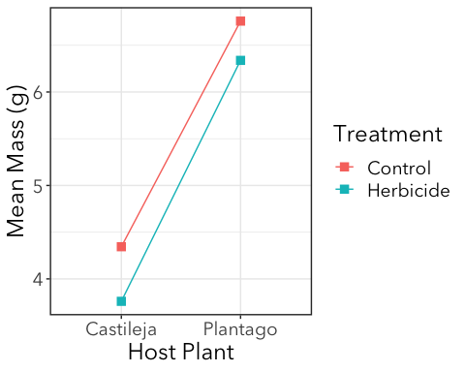

Slide 40
Model competition with AIC
AIC(m0, m1, m2, m3, m4)
## df AIC ## m0 2 1207.970 ## m1 3 1206.145 ## m2 3 1086.878 ## m3 4 1082.661 ## m4 5 1084.491

Slide 41
Marginal Hypothesis Test
Starting with a “full” model, marginal hypothesis testing test the effects of one predictor over the range of other predictors.
Not quite the same as sequentially testing nested models with LRT, but similar.
You don’t have to worry about nestedness!
library(car)
## Loading required package: carData
## ## Attaching package: 'car'
## The following object is masked from 'package:dplyr': ## ## recode
## The following object is masked from 'package:purrr': ## ## some
Anova(m4)
## Analysis of Deviance Table (Type II tests) ## ## Response: mass ## LR Chisq Df Pr(>Chisq) ## host 155.777 1 < 2e-16 *** ## treat 6.200 1 0.01278 * ## host:treat 0.168 1 0.68177 ## --- ## Signif. codes: 0 '***' 0.001 '**' 0.01 '*' 0.05 '.' 0.1 ' ' 1
Things to know:
These are the p-values you’re looking for
Do not trust the p-values from anova() (lowercase “a”)! It does sequential testing, which is not the same as marginal testing, and isn’t appropriate in some cases. car::Anova() (capital “A”) will almost always do the correct thing.

Slide 42
Review of means paramaterization vs. effects paramaterization
Using our coefficients and GLM equation, we figured out the expected mean mass of caterpillars in all 4 treatment x host plant combinations:
$$E[x_{i}]=β_{0}+β_{1}H_{i}+β_{2}P_{i}+β_{3}H_{i}P_{i}$$
coef(m4) %>% round(2)
## (Intercept) hostPlantago ## 4.34 2.41 ## treatHerbicide hostPlantago:treatHerbicide ## -0.58 0.16
Castilleja & control = 4.34 Castilleja & herbicide = 3.76 Plantago & control = 6.76 Plantago & herbicide = 6.34
Can we get these an easier way?

Slide 43
Effects paramaterization
m_effects <- glm(mass ~ treat*host, family = gaussian, data = cats) summary(m_effects)
## ## Call: ## glm(formula = mass ~ treat * host, family = gaussian, data = cats) ## ## Deviance Residuals: ## Min 1Q Median 3Q Max ## -4.3584 -1.0738 -0.1184 0.8050 10.1316 ## ## Coefficients: ## Estimate Std. Error t value Pr(>|t|) ## (Intercept) 4.3444 0.2193 19.806 < 2e-16 *** ## treatHerbicide -0.5844 0.3162 -1.848 0.0657 . ## hostPlantago 2.4144 0.2778 8.690 3.14e-16 *** ## treatHerbicide:hostPlantago 0.1639 0.3998 0.410 0.6821 ## --- ## Signif. codes: 0 '***' 0.001 '**' 0.01 '*' 0.05 '.' 0.1 ' ' 1 ## ## (Dispersion parameter for gaussian family taken to be 2.646255) ## ## Null deviance: 1166.64 on 282 degrees of freedom ## Residual deviance: 738.31 on 279 degrees of freedom ## AIC: 1084.5 ## ## Number of Fisher Scoring iterations: 2
Anova(m_effects)
## Analysis of Deviance Table (Type II tests) ## ## Response: mass ## LR Chisq Df Pr(>Chisq) ## treat 6.200 1 0.01278 * ## host 155.777 1 < 2e-16 *** ## treat:host 0.168 1 0.68177 ## --- ## Signif. codes: 0 '***' 0.001 '**' 0.01 '*' 0.05 '.' 0.1 ' ' 1

Slide 44
Means paramaterization
Not quite what we want in this case
m_means <- glm(mass ~ -1 + treat*host, family = gaussian, data = cats) summary(m_means)
## ## Call: ## glm(formula = mass ~ -1 + treat * host, family = gaussian, data = cats) ## ## Deviance Residuals: ## Min 1Q Median 3Q Max ## -4.3584 -1.0738 -0.1184 0.8050 10.1316 ## ## Coefficients: ## Estimate Std. Error t value Pr(>|t|) ## treatControl 4.3444 0.2193 19.81 < 2e-16 *** ## treatHerbicide 3.7600 0.2278 16.51 < 2e-16 *** ## hostPlantago 2.4144 0.2778 8.69 3.14e-16 *** ## treatHerbicide:hostPlantago 0.1639 0.3998 0.41 0.682 ## --- ## Signif. codes: 0 '***' 0.001 '**' 0.01 '*' 0.05 '.' 0.1 ' ' 1 ## ## (Dispersion parameter for gaussian family taken to be 2.646255) ## ## Null deviance: 10109.41 on 283 degrees of freedom ## Residual deviance: 738.31 on 279 degrees of freedom ## AIC: 1084.5 ## ## Number of Fisher Scoring iterations: 2
treatControl = expected mean of Castilleja & control
treatHerbicide = expected mean of Castilleja & herbicide
hostPlantago = difference in means between treatControl and Plantago & control
treatHerbicide:hostPlantago = difference in means between treatHerbicide and Plantago & herbicide

Slide 45
Means paramterization
Also, if you use means paramaterization (~ -1 + treat*host), then the Anova() results are not correct!
m_effects$call
## glm(formula = mass ~ treat * host, family = gaussian, data = cats)
Anova(m_effects)
## Analysis of Deviance Table (Type II tests) ## ## Response: mass ## LR Chisq Df Pr(>Chisq) ## treat 6.200 1 0.01278 * ## host 155.777 1 < 2e-16 *** ## treat:host 0.168 1 0.68177 ## --- ## Signif. codes: 0 '***' 0.001 '**' 0.01 '*' 0.05 '.' 0.1 ' ' 1
m_means$call
## glm(formula = mass ~ -1 + treat * host, family = gaussian, data = cats)
Anova(m_means)
## Analysis of Deviance Table (Type II tests) ## ## Response: mass ## LR Chisq Df Pr(>Chisq) ## treat 667.52 2 <2e-16 *** ## host 155.78 1 <2e-16 *** ## treat:host 0.17 1 0.6818 ## --- ## Signif. codes: 0 '***' 0.001 '**' 0.01 '*' 0.05 '.' 0.1 ' ' 1

